Slide 1
Explore compute and storage options for data engineering workloads
Subtitle Goes Here

Slide 2
Agenda
Describe Azure Databricks
Introduction to Azure Data Lake storage
Describe Delta Lake architecture
Work with data streams by using Azure Stream Analytics
Notes:
TALKING POINTS
Let’s set an agenda for today’s presentation in which we are going to discuss the following:
Describe Azure Synapse serverless SQL pools
Querying a data lake store using serverless SQL pools in Azure Synapse Analytics
Securing access to data through using serverless SQL pools in Azure Synapse Analytics
PRESENTER NOTES AND GUIDANCE
Don’t take too much time in order to present the agenda. Make the points in the topics.

Slide 3
Describe Azure Databricks
1
Subtitle Goes Here
Notes:
TALKING POINTS
Let’s go over fundamental data modeling for optimizing analytical workloads. How many of you have heard of a star or snowflake schema?
PRESENTER NOTES AND GUIDANCE
Poll your audience.

Slide 4

What is Azure Databricks?
Apache Spark-based analytics platform:
Simplifies the provisioning and collaboration of Apache Spark-based analytical solutions dealing with batch and streaming data
Comprehensive Spark library support:
Support includes SQL, DataFrames, MLlib, Hyperspace and MSSparkUtil
Enterprise Security:
Utilizes the security capabilities of Azure
Integration with other Cloud Services:
Can integrate with a variety of Azure data platform services and Power BI
Notes:
Talking points
Azure Databricks is a managed Spark as a Service propriety solution that provides an end-to-end data engineering/data science platform as a solution. Azure Databricks is of interest for Data Engineers and Data Scientists, working on big data projects daily because it provides the whole platform in which you have the ability to create and manage the big data/data science pipelines/projects all on 1 platform.
It is likely that you may have students that use Azure Databricks already. One of the commons questions that is asked by customers is whether Azure Databricks can work with Azure Synapse Analytics. The answer is yes. There are example of customers who use Azure Databricks for the Spark capabilities, and Azure Synapse Analytics for the data warehousing, integration and visualization capabilities successfully.
Recommended reading for this slide
Describe Azure Databricks - Learn | Microsoft Docs
Spark architecture fundamentals - Learn | Microsoft Docs

Slide 5
Introduction to Azure Data Lake storage
2

Slide 6
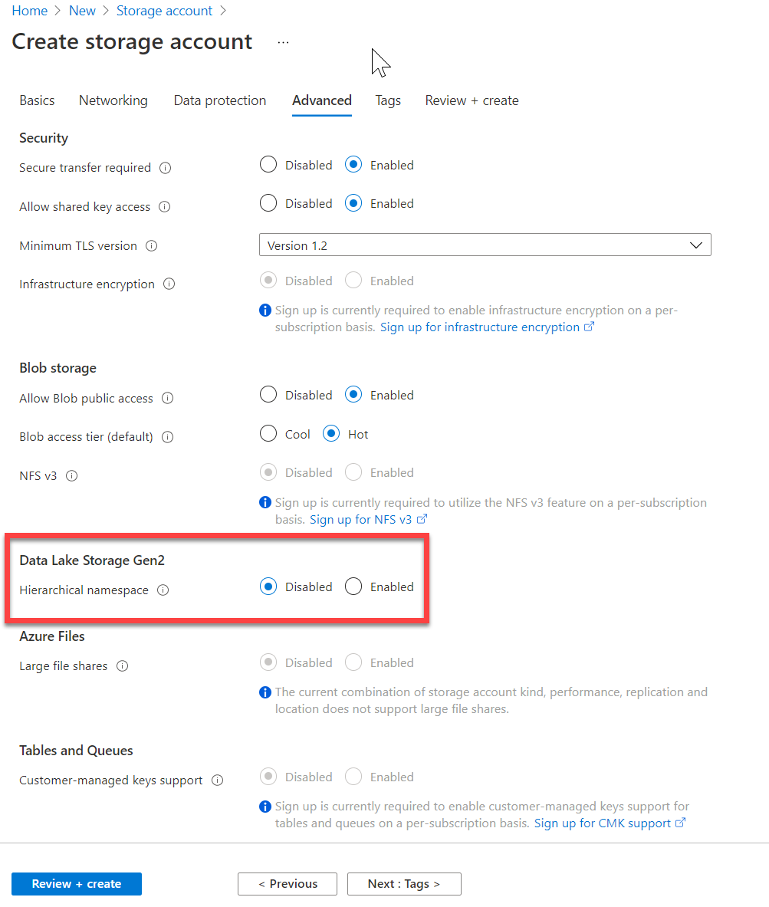
Introduction to Azure Data Lake storage
Hadoop compatible
Security
Performance
Redundancy
Notes:
Talking points
The first point of “Hadoop Access” is a key differentiator for using Azure Data Lake Storage Gen2 (ADLSG2) over Blob storage.
Coupled with the security model that provides very granular permissions, this makes ADLSG2 a compelling data storage tier for a range of Azure data platform technologies including Azure Synapse and Azure Databricks.
The ability to perform big data analytics is critical and the performance of ADLSG2 helps with that performance.
All of this comes with the Geo redundancy capability to ensure that the data is safe.
Instructor notes and guidance
This will be the only module where we cover Azure Data Lake store in depth, and it is the reason why the lab focuses so much on how the data lake can be optimized while using the compute technologies. As a result, you can spend some time on the list in the slide, and ultimately state to the students that all this is achieved with a single selection of a radio button when you create a storage account.
Recommended reading for this slide
Introduction to Azure Data Lake storage - Learn | Microsoft Docs

Slide 7
Organizing data in the data lake
Separate storage accounts for each environment: dev, test, & production.
Use a common folder structure to organize data by degree of refinement.
ADLS Gen 2 Filesystem
Raw Data
/bronze
Query Ready
/silver
Report Ready
/gold
Notes:
The first thing we should consider as we look at ingesting data into the data lake is how to structure or organize data within the data lake.
The recommendation for structuring folders to manage the data at the various levels of refinement in the data lake is as follows:
You should use Azure Data Lake Store (ADLS) Gen2 (Within the Azure portal, this is an Azure Storage account with a hierarchical namespace enabled).
A key mechanism that ADLS Gen2 to provide file system performance at object storage scale and prices is the addition of a hierarchical namespace. This allows the collection of objects/files within an account to be organized into a hierarchy of directories and nested subdirectories in the same way that the file system on your computer is organized. With a hierarchical namespace enabled, a storage account becomes capable of providing the scalability and cost-effectiveness of object storage, with file system semantics that are familiar to analytics engines and frameworks.
In ADLS, it is a best practice to have a dedicated Storage Account for production, and a separate Storage Account for dev and test workloads. This will ensure that dev or test workloads never interfere with production.
A common method for structuring folders within a data lake is to organize data in separate folders by the degree of refinement. For example:
Bronze tables contain raw data ingested from various sources (JSON files, RDBMS data, IoT data, etc.).
Silver tables will provide a more refined view of our data. We can join fields from various bronze tables to enrich streaming records, or update account statuses based on recent activity.
Gold tables provide business level aggregates often used for reporting and dashboarding. This would include aggregations such as daily active website users, weekly sales per store, or gross revenue per quarter by department.
Important to note:
When data is stored in Data Lake Storage Gen2, the file size, number of files, and folder structure have an impact on performance. The following section describes best practices in these areas.
If you store your data has many small files, this can negatively affect performance. In general, organize your data into larger sized files for better performance (256MB to 100GB in size).
Some engines and applications might have trouble efficiently processing files that are greater than 100GB in size.
Sometimes, data pipelines have limited control over the raw data which has lots of small files. It is recommended to have a "cooking" process that generates larger files to use for downstream applications.

Slide 8
Describe Delta Lake architecture
3

Slide 9
Using a lambda architecture
Speed Layer
Input Data
Analytics Client
Real-Time Views
“Hot” Path
Batch Layer
Serving Layer
Master Data
Batch Views
“Cold” Path
Notes:
When working with very large data sets, it can take a long time to run the sort of queries that clients need. These queries can't be performed in real time, and often require algorithms such as MapReduce that operate in parallel across the entire data set. The results are then stored separately from the raw data and used for querying.
One drawback to this approach is that it introduces latency — if processing takes a few hours, a query may return results that are several hours old. Ideally, you would like to get some results in real time (perhaps with some loss of accuracy), and combine these results with the results from the batch analytics.
The lambda architecture, first proposed by Nathan Marz, addresses this problem by creating two paths for data flow. All data coming into the system goes through these two paths:
A batch layer (cold path) stores all of the incoming data in its raw form and performs batch processing on the data. The result of this processing is stored as a batch view.
A speed layer (hot path) analyzes data in real time. This layer is designed for low latency, at the expense of accuracy.
The batch layer feeds into a serving layer that indexes the batch view for efficient querying. The speed layer updates the serving layer with incremental updates based on the most recent data.
Data that flows into the hot path is constrained by latency requirements imposed by the speed layer, so that it can be processed as quickly as possible. Often, this requires a tradeoff of some level of accuracy in favor of data that is ready as quickly as possible. For example, consider an IoT scenario where a large number of temperature sensors are sending telemetry data. The speed layer may be used to process a sliding time window of the incoming data.
Data flowing into the cold path, on the other hand, is not subject to the same low latency requirements. This allows for high accuracy computation across large data sets, which can be very time intensive.
Eventually, the hot and cold paths converge at the analytics client application. If the client needs to display timely, yet potentially less accurate data in real time, it will acquire its result from the hot path. Otherwise, it will select results from the cold path to display less timely but more accurate data. In other words, the hot path has data for a relatively small window of time, after which the results can be updated with more accurate data from the cold path.
The raw data stored at the batch layer is immutable. Incoming data is always appended to the existing data, and the previous data is never overwritten. Any changes to the value of a particular datum are stored as a new timestamped event record. This allows for recomputation at any point in time across the history of the data collected. The ability to recompute the batch view from the original raw data is important, because it allows for new views to be created as the system evolves.

Slide 10
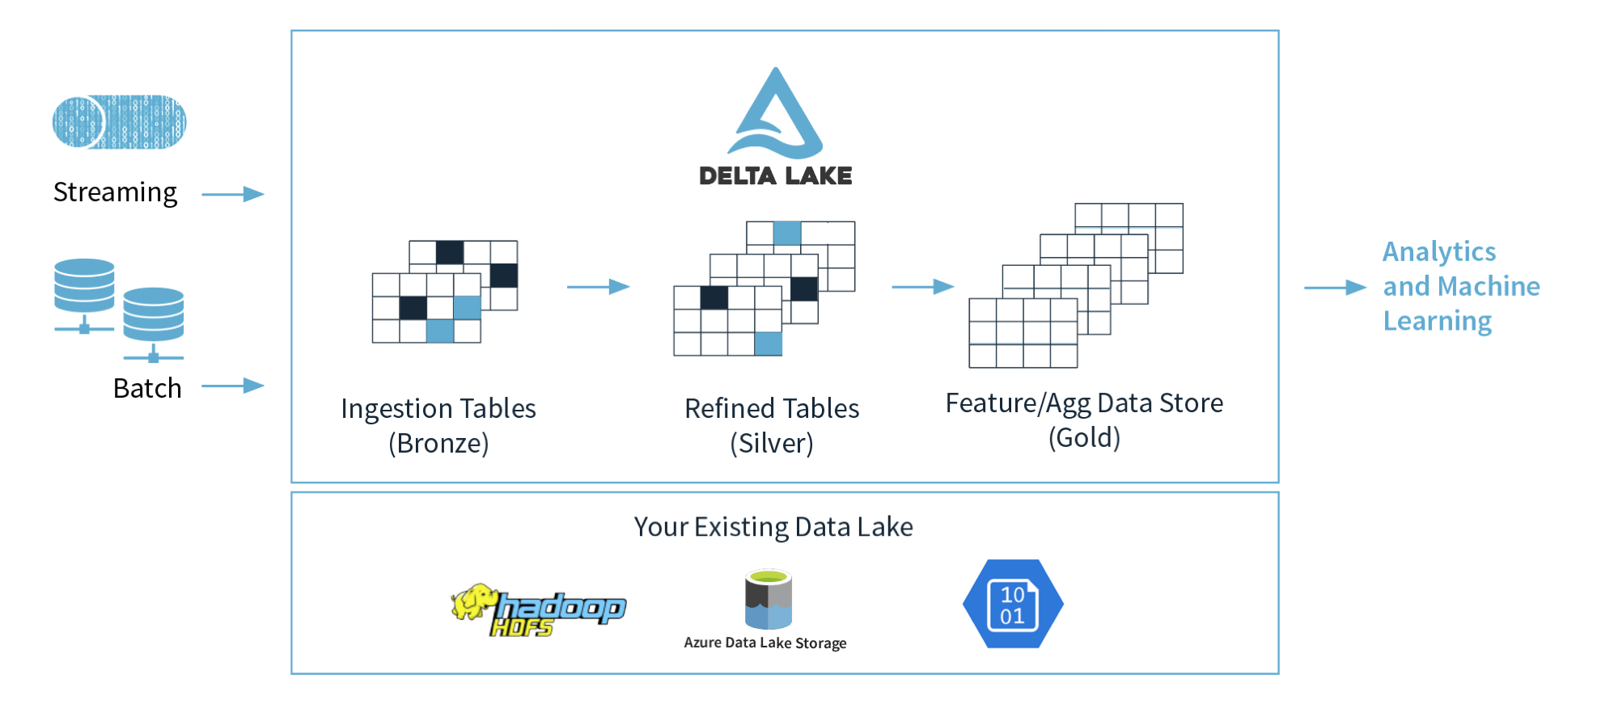
Describe a Delta Lake architecture
Notes:
Talking points
The Delta Lake Architecture is a vast improvement upon the traditional Lambda architecture. At each stage, we enrich our data through a unified pipeline that allows us to combine batch and streaming workflows through a shared filestore with ACID-compliant transactions.
Delta Lake is an open-source storage layer that brings ACID (atomicity, consistency, isolation, and durability) transactions to Apache Spark and big data workloads. The current version of Delta Lake included with Azure Synapse has language support for Scala, PySpark, and .NET. It is also supported on Azure Databricks. Using delta lake in a well organised data lake can aid the integrity and performance of both batch and streaming data solutions. The common misconception made with Delta lake is that people think it is a data platform service. It’s not. It is simply a format that is defined when you create a DataFrame against the storage layer, and this is what brings the ACID capabilities to the data held in the DataFrames. Couple this with organising the folders in an appropriate way, then you have an approach that can scale in an organised way that prevents your data lake becoming a data “swamp”.
In the example above, the data lake is organized using the bronze, silver and gold architecture. The input method is irrelevant, it can either be a streaming solution, or a batch solution. Essentially, we organise our data into layers, or folders as defined as bronze, silver and gold as follows:
Bronze - tables contain raw data ingested from various sources (JSON files, RDBMS data, IoT data, etc.).
Silver - tables will provide a more refined view of our data. We can join fields from various bronze tables to enrich streaming records, or update account statuses based on recent activity.
Gold - tables provide business level aggregates often used for reporting and dashboarding. This would include aggregations such as daily active website users, weekly sales per store, or gross revenue per quarter by department.
The end outputs are actionable insights, dashboards, and reports of business metrics.
Instructor notes and guidance
While this is an open-source technology that is not covered by the exam objectives, it is an important area that is growing in the data engineering world and being seen by some data engineers as an architecture to replace the lambda architecture model. It is also covered in depth in the lab as we explore Azure Databricks implementing the delta lake architecture in the data lake store. In the lab, you will explore this architecture being created using Azure Databricks, but it could be done in Azure Synapse Analytics too.
You should call out the common misconception laid out in the talking points above. Make sure your students understand that Delta Lake if a format. Not a service.
Recommended reading for this slide
Describe Azure Databricks Delta Lake architecture - Learn | Microsoft Docs
Build and query a Delta Lake - Learn | Microsoft Docs

Slide 11
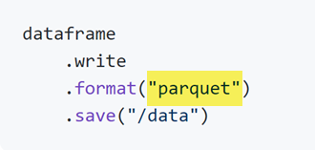
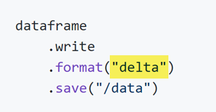
How to use Delta format
…simply create a table using delta
Instead of creating a table using parquet…

Slide 12
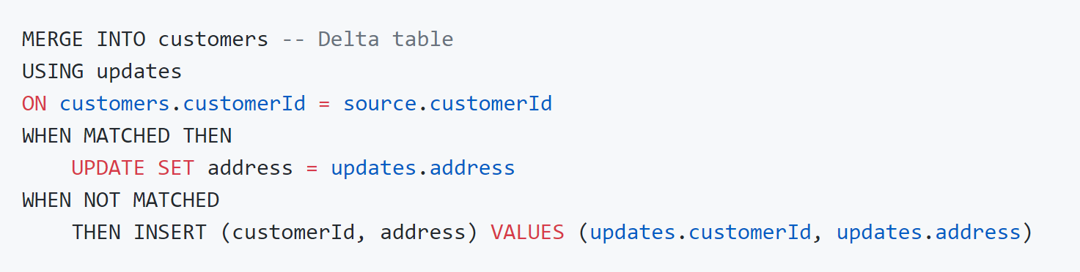
Upsert syntax
Notes:
To UPSERT means to "UPdate" and "inSERT". In other words, UPSERT is literally TWO operations. It is not supported in traditional data lakes, as running an UPDATE could invalidate data that is accessed by the subsequent INSERT operation.
Using Delta Lake, however, we can do UPSERTS. Delta Lake combines these operations to guarantee atomicity to
INSERT a row
if the row already exists, UPDATE the row.

Slide 13
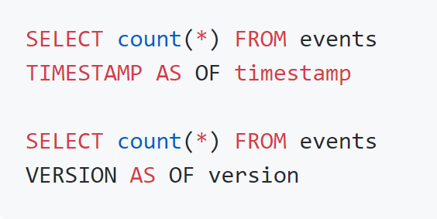
Time travel syntax
Basic syntax using SQL:
Load an older version:
Notes:
Because Delta Lake is version controlled, you have the option to query past versions of the data. Using a single file storage system, you now have access to several versions your historical data, ensuring that your data analysts will be able to replicate their reports (and compare aggregate changes over time) and your data scientists will be able to replicate their experiments.
Other time travel use cases are:
Re-creating analyses, reports, or outputs (for example, the output of a machine learning model). This could be useful for debugging or auditing, especially in regulated industries.
Writing complex temporal queries.
Fixing mistakes in your data.
Providing snapshot isolation for a set of queries for fast changing tables.
If you want to access the data that you overwrote, you can query a snapshot of the table before you overwrote the first set of data using the versionAsOf option.
You should see the first set of data, from before you overwrote it. Time travel takes advantage of the power of the Delta Lake transaction log to access data that is no longer in the table. Removing the version 0 option (or specifying version 1) would let you see the newer data again.

Slide 14
Work with data streams by using Azure Stream Analytics
4

Slide 15
Work with data streams by using Azure Stream Analytics
Complex event processing of Stream Data in Azure
Event producer
Complex Event Processor
Event consumer
Notes:
Talking points
Azure Stream Analytics provides event processing of streaming data as a service. Somewhat narrower in scope than the streaming capabilities provided by Azure Databricks, Azure Stream Analytics provides a simple and very cost-effective way to process events. For instance, analyzing streams of data for time-sequence relationships using a SQL-like query. You also can output the data to Azure Data Lake, Azure Synapse Analytics and Power BI to provide near-real-time reporting.
Instructor notes and guidance
Talk about Stream Analytics at a conceptual level as per the slide, where Stream Analytics solutions are broken down into three part:
Event producer: Examples include sensors or processes that generate data continuously, such as a heart rate monitor or a highway toll lane sensor.
Event processor: An engine to consume event data streams and derive insights from them. Depending on the problem space, event processors either process one incoming event at a time, such as a heart rate monitor, or process multiple events at a time, such as Azure Stream Analytics processing the highway toll lane sensor data.
Event consumer: An application that consumes the data and takes specific action based on the insights. Examples of event consumers include alert generation, dashboards, or even sending data to another event processing engine.
Share with the students that event processing uses Stream Analytics query language (SAQL), a subset of Transact-SQL that's tailored to perform computations over streaming data. The engine supports windowing functions that are fundamental to stream processing and are implemented by using the SAQL.
Recommended reading for this slide
Work with data streams by using Azure Stream Analytics - Learn | Microsoft Docs

Slide 16
LAB: Explore compute and storage options for data engineering workloads
60 minutes
Notes:
TALKING POINTS​
​
Let’s put this into reality and show you how it works.​
​
All instructions and context are found in this repository​

Slide 17
Notes:
TALKING POINTS​
​
This slide links to our content on Microsoft Learn

